Slide 1




ORM Basics - Doctrine Advanced
ORM Table Relations, Complex Queries, Custom Repository Methods
PHP MVC Frameworks
Veselin Malezanov
Technical Trainers
Software University
http://softuni.bg

Slide 2


Table of Contents
ORM Basics - Doctrine
Entity Manager
Entity Repository

Slide 3
Have a question?
#sli.do
#PHP-WEB

Slide 4


ORM Basics - Doctrine
Doctrine DBAL, Doctrine ORM

Slide 5
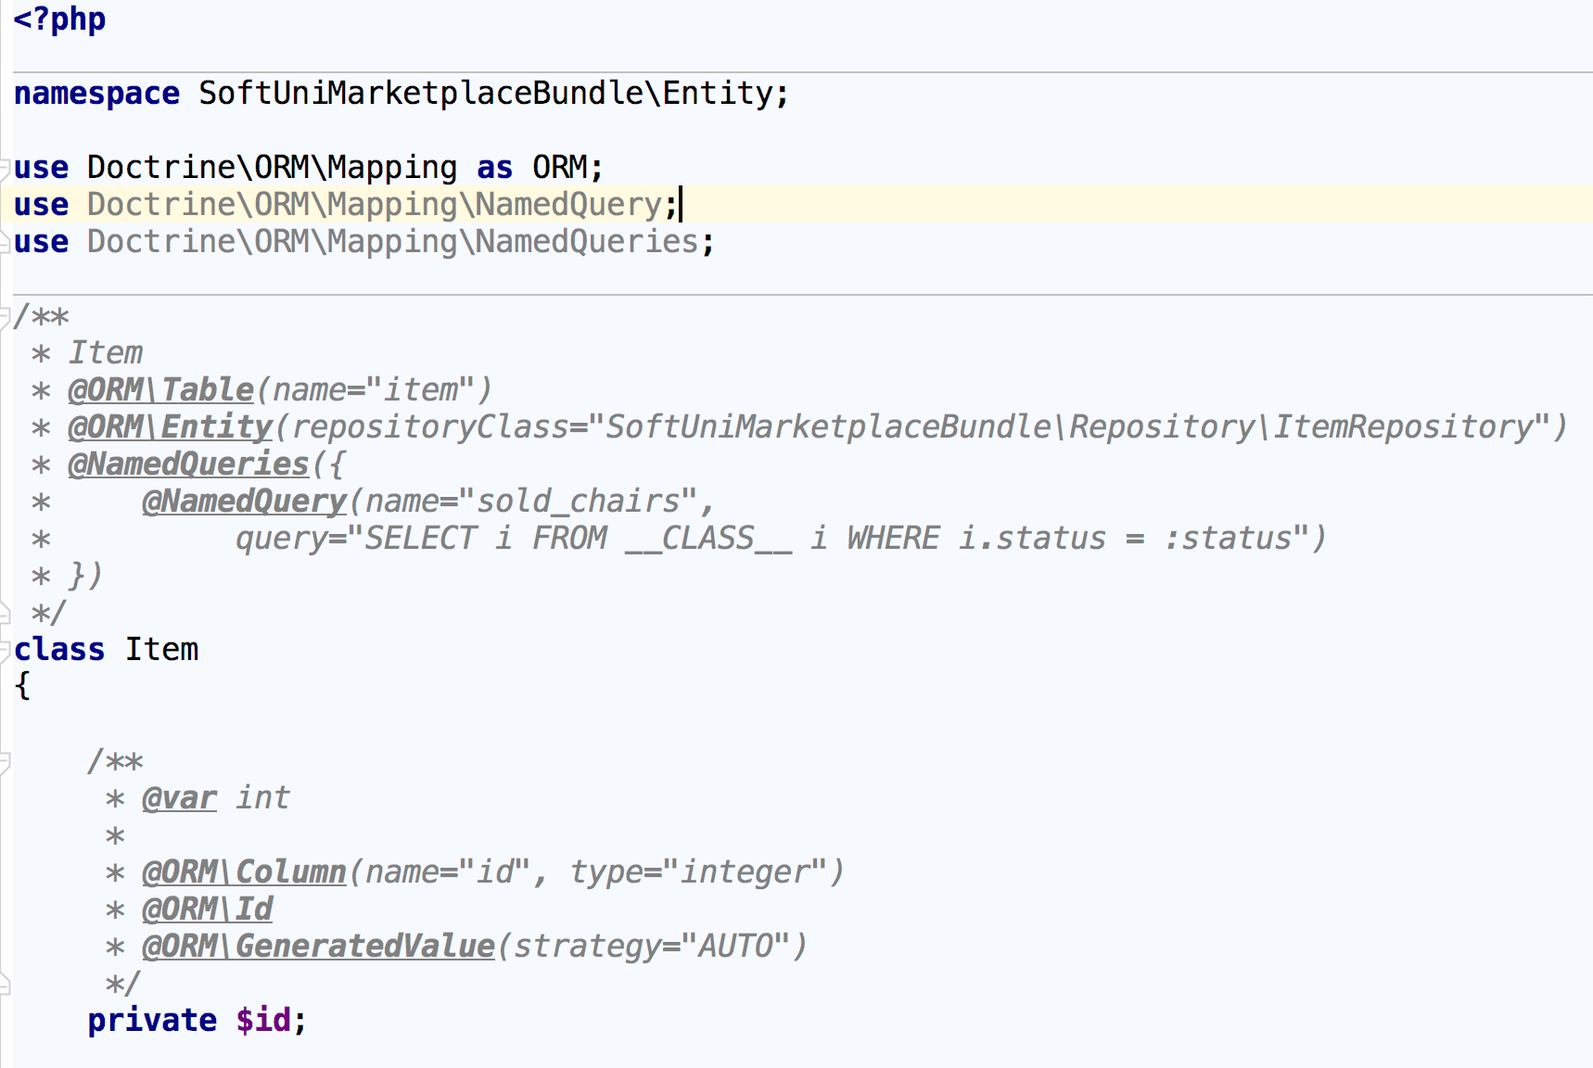
Doctrine ORM
Doctrine Entity

Slide 6
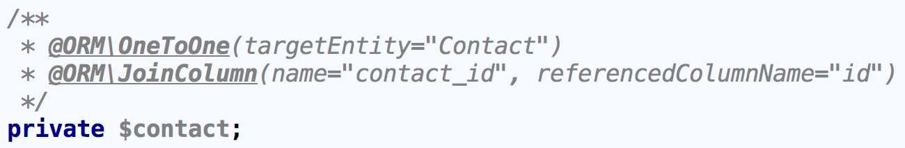
Doctrine ORM
Doctrine Entity - Table Relations
@OneToOne - each row in one table is linked to exactly one row in another table

Slide 7
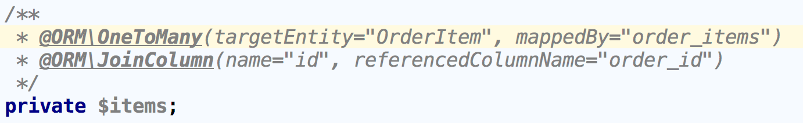
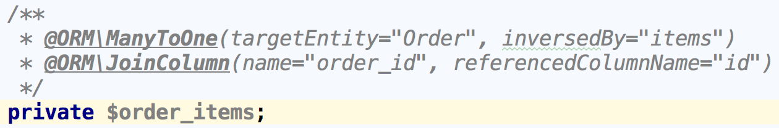
Doctrine ORM
Doctrine Entity - Table Relations
@OneToMany - each row in one table is linked to many rows in another table
Order.php
OrderItem.php

Slide 8
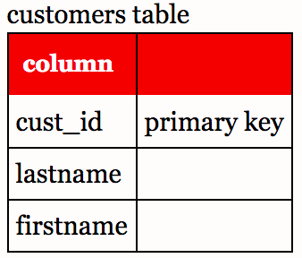
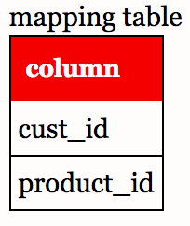
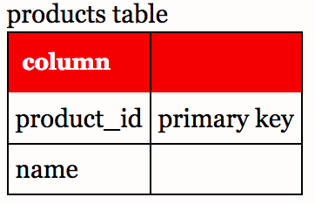
Doctrine ORM
Doctrine Entity - Join Tables
@ManyToMany - one or more rows in a table can be related to 0, 1 or many rows in another table
Many-to-many relation is implemented with join table / mapping table

Slide 9
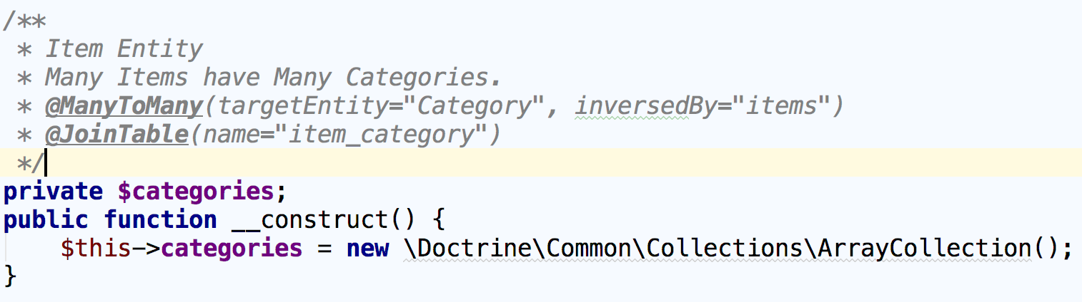
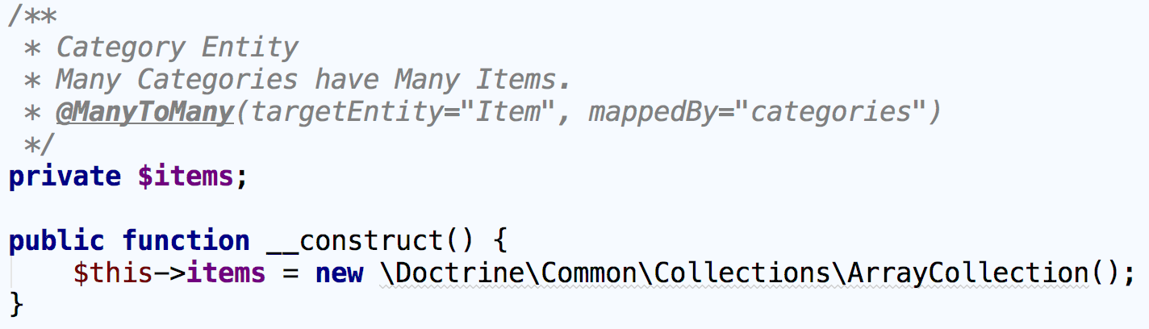
Doctrine ORM
Doctrine Entity - Join Tables
Item.php
Category.php

Slide 10
EntityManager
Manage entities - persist(), remove(), flush()
createQuery() - allows us to execute DQL queries
createNamedQuery() - allows us to execute named DQL queries
createQueryBuilder() - allows us to create queries using object-oriented approach

Slide 11
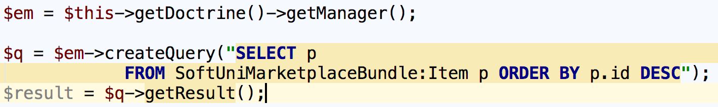
EntityManager
Doctrine Query Language - DQL
Very similar to SQL
With DQL we can update, delete, select entities, but not persist
With DQL we select objects instead of table rows

Slide 12
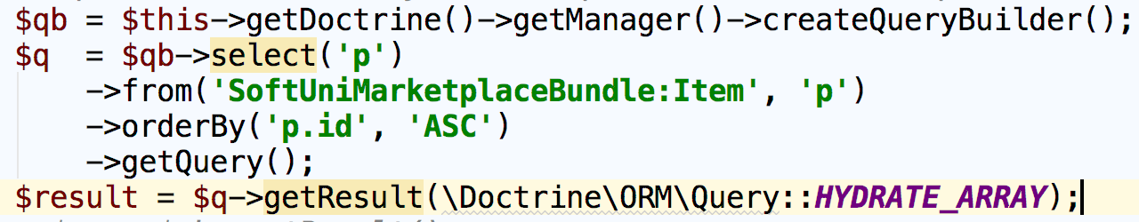
EntityManager
Entity Manager: Hydration
\Doctrine\ORM\Query::HYDRATE_OBJECT
\Doctrine\ORM\Query::HYDRATE_ARRAY
\Doctrine\ORM\Query::HYDRATE_SCALAR
\Doctrine\ORM\Query::HYDRATE_SINGLE_SCALAR
\Doctrine\ORM\Query::HYDRATE_SIMPLEOBJECT

Slide 13
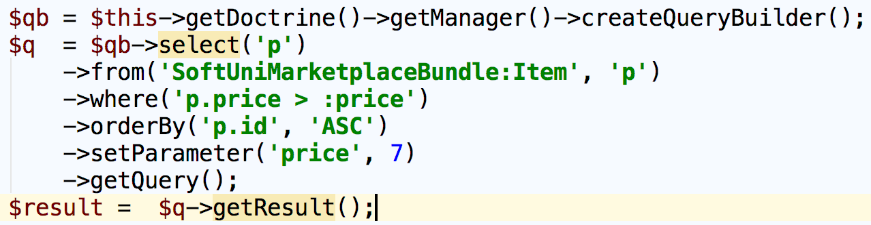
EntityManager
Doctrine Query Builder
Create query in object oriented approach

Slide 14
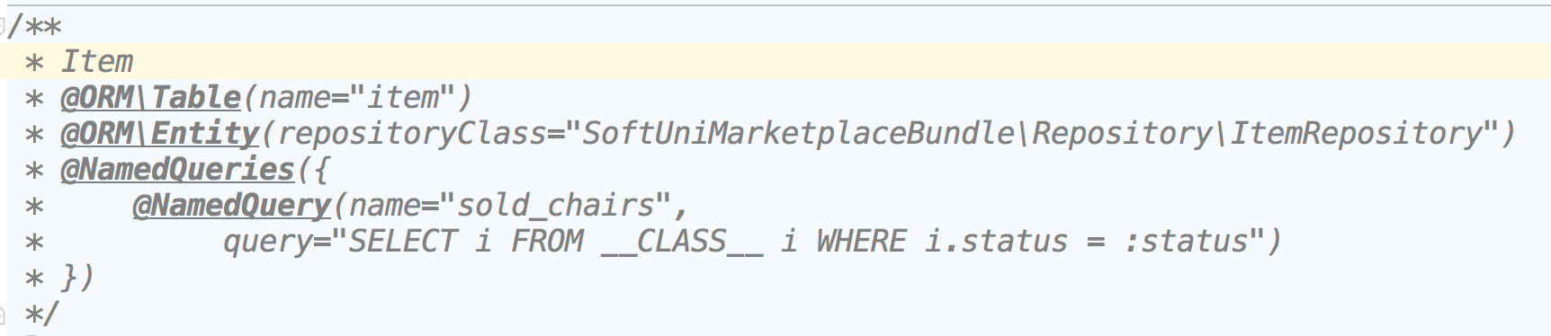
EntityManager
Doctrine Entity - Named Queries
Think of giving descriptive name to query
Named queries are written in DQL
Import in your entity class

Slide 15
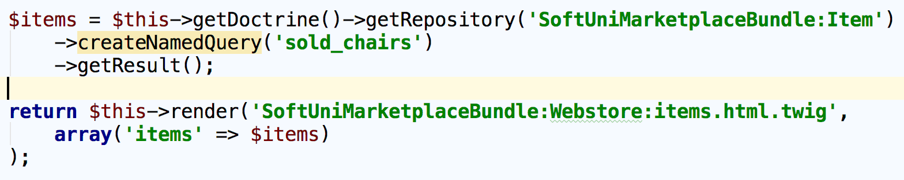
Doctrine ORM
Named Query Example

Slide 16
Problems
Experiment with DQL and NamedQueries
Experiment with the QueryBuilder
Persist entities to database

Slide 17

Entity Repository
Entity Repository, Helper Methods

Slide 18
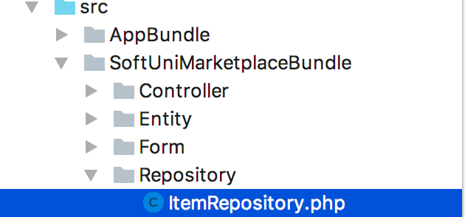
Entity Repository
Makes your code reusable
Isolates your queries from other logic
Provides access to helper methods for each property of your entity
Where the EntityRepository class lives?

Slide 19
Entity Repository Class
How to create?
Automatically created when executing: php bin/console doctrine:generate:entities SomeBundle
Above command will generate Doctrine Entity and empty repository class

Slide 20
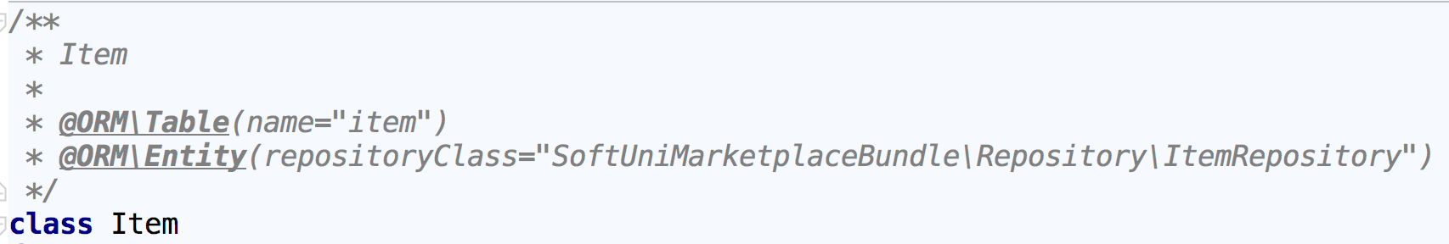
Entity Repository Class
How to create?
Manually
Configure repositoryClass in your entity
In your entity repository class

Slide 21
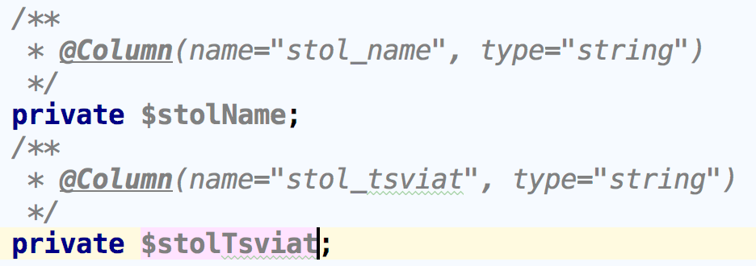
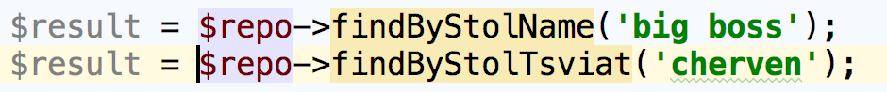
Entity Repository Class
Extending Doctrine\ORM\EntityRepository allows us to access dynamic helper methods for each mapped entity property
Now you have dynamic method names for our entity properties without writing single line of code

Slide 22
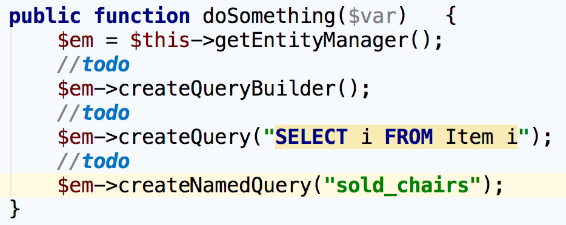
Entity Repository Class
How to access the EntityManager in your repository class

Slide 23
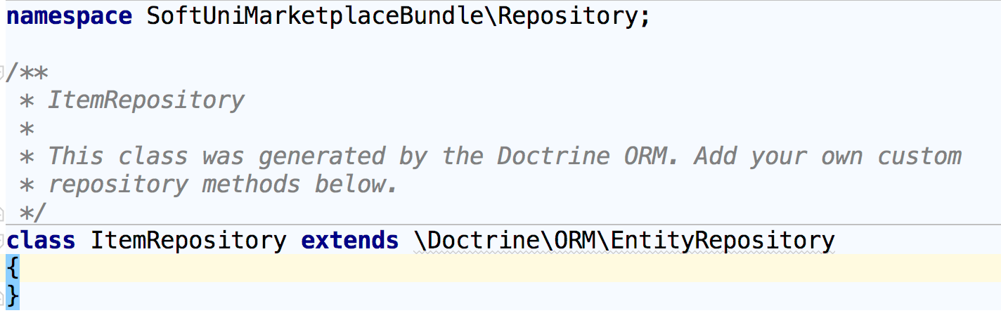
Entity Repository Class
How to create?
Create repository class in src/YourBundle/Repository

Slide 24
Summary
Doctrine ORM - Basic entity mapping, DBAL
Entity Manager - QueryBuilder, DQL, NamedQueries
Entity Repository - Dynamic helper methods,

Slide 25
REST Controllers and Routing
https://softuni.bg/courses/

Slide 26
License
This course (slides, examples, demos, videos, homework, etc.) is licensed under the "Creative Commons Attribution-NonCommercial-ShareAlike 4.0 International" license

Slide 27



Trainings @ Software University (SoftUni)
Software University – High-Quality Education, Profession and Job for Software Developers
softuni.bg
Software University Foundation
softuni.org
Software University @ Facebook
facebook.com/SoftwareUniversity
Software University Forums
forum.softuni.bg

